Slide 1
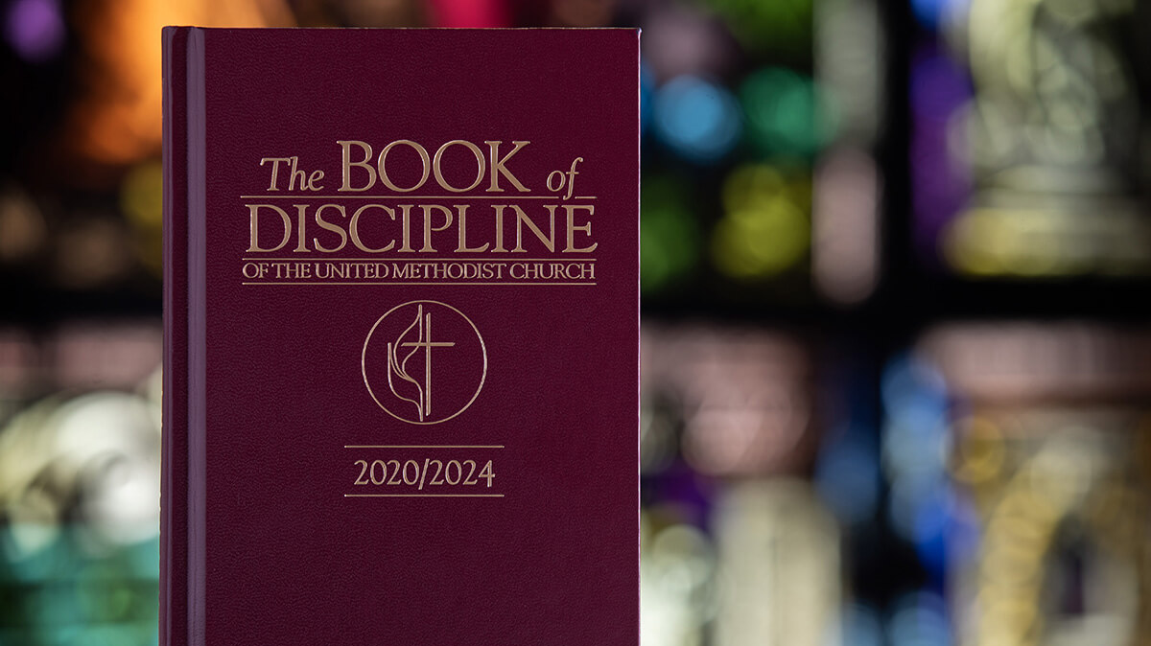
Essentials of a decision of law
How to write and submit a ruling of law
Rev. Luan-Vu “Lui” Tran, Ph.D.

Slide 2
Bishops have limited judicial authority
¶ 52. Article VII.—A bishop presiding over an annual, central, or jurisdictional conference shall decide all questions of law coming before the bishop in the regular business of a session, provided that such questions be presented in writing and that the decisions be recorded in the journal of the conference.
Such an episcopal decision shall not be authoritative except for the pending case until it shall have been passed upon by the Judicial Council. All decisions of law made by each bishop shall be reported in writing annually, with a syllabus of the same, to the Judicial Council, which shall affirm, modify, or reverse them.

Slide 3
What to do when you receive a request
Get a written copy of the request, including Question of Law, from the member of annual conference.
Make sure that the request is properly recorded by the Conference Secretary.
Decide whether you want to rule while in session or within 30 days.
Unless the request is clearly improper and out of order, you may want to take the 30 days permitted by ¶ 2609.6.

Slide 4
Identify the issues
In many cases, the question of law outlines the issue(s).
Example: Is Resolution RS-3 adopted by Dopey Annual Conference, entitled “Let’s Get Stoned Together,” particularly Section 6(a)(3) permitting the use of marijuana-laced bread for Holy Communion, in conflict with General Conference’s power over “all matters relating to the form and mode of worship” under ¶ 16.6 of the Constitution?
The request must raise a question of law. It is improper if it states an opinion.
Example: Bishop, I request a decision of law regarding Resolution RS-3 which I think is a crazy idea and those who wrote it must have been out of their mind.
The request cannot raise a question of fact or stipulate a fact.
Example: Bishop, I request a ruling of law to determine if the Board of Trustees was involved in the drafting of Resolution RS-3.

Slide 5
FIND THE APPLICABLE LAW
Often the Question of Law cites the pertinent provisions of the Discipline.
Bishops are expected to know Church law. They have the duty to determine if the citations in the request are correct or if other provisions are applicable.
Start with the Constitution, asking: Does the resolution or action of the annual conference violate any constitutional provision or principle?
Continue with the Discipline (General Conference legislation), asking: Which parts, sections, and paragraphs of the Discipline address the issues raised?
Follow up with Jurisprudence, asking: Has the Judicial Council ruled on this issue before? If so, how did it rule? And does that ruling still have precedential value? (NOTE: Some provisions in the Discipline contain footnote references to JCDs.

Slide 6
How to break it down to core issue
Question 2
Question 1
Question 3
CORE ISSUE

Slide 7
Why is it important to identify the issue?
Scope of case
Core Issue
¶ A
¶ B
Narrowing down to core issue helps you to find the controlling provision
¶ C

Slide 8
JCD 1437
CORE ISSUE: Who has the authority to determine whether a legislative petition meets the submission requirements?
Cited provisions: ¶¶ 507.5, 507.6, 507.8, 507.9
Controlling provision: ¶ 507.1
Question of Law: Is a legislative petition adopted and submitted by an annual conference properly before the postponed 2020 General Conference?

Slide 9
Deductive Legal Reasoning
Particular Fact
Conclusion
General Rule
Example:
General Rule: Pastors shall not discontinue services without the consent of the charge conference and the district superintendent. (¶ 341.2)
Particular Fact: Scoobeedoo AC adopts a policy permitting pastors to discontinue worship services at their sole discretion.
Conclusion: The conference policy is in direct conflict with the General Rule (¶ 341.2) and, therefore, null and void.

Slide 10
Most COMMONLY raised issues
Is a conference resolution aspirational or prescriptive? See JCD 1340, 1392, 1398, 1399, 1435
Does a conference resolution negate, ignore, or violate provisions of the Discipline? See JCD 823, 886, 1044, 1105, 1435
Did an annual conference or any of its bodies act without authority? See JCD 878, 1023, 1111, 1371, 1398
Is a conference policy an unconstitutional delegation of power? See JCD 78, 79, 380, 400, 584, 590, 599

Slide 11
Writing tips
Provide a clear and chronological statement of facts, incl. text of the request.
Avoid using sentences with multiple subordinate clauses: “During the discussion of a resolution that was submitted by clergy persons who suffered from the economic impact that was caused by rising energy prices which affected the entire state…”
Beware of double negatives: “This conference policy neither negates nor nullifies The Discipline.”
Strive for comprehension and persuasion.
It’s more important to identify and analyze the correct provisions of The Discipline than to cite a lot of judicial precedents.
Less is more: short, concise, and cogent decisions are more effective.
Adding a Digest summarizing the ruling is a plus, not a must.

Slide 12
Four Basic components of a decision of law
1. STATEMENT OF FACTS: What happened? What is the question? Information based on official record of the annual conference
2. JURISDICTION: Is it a proper question? Is it moot & hypothetical? Determination if the question meets the Connection Test
3. ANALYSIS & RATIONALE: What are the legal bases and rationale? Explanation of the grounds for the decision
4. RULING: How do you decide? Disposition of the case

Slide 13
Submitting the decision of law
Within thirty (30) days after the close of the session. ¶ 2609.6
With the following form and attachments:
Form ”Report by Bishop on Decision of Law”
Decision of Law
Text of the written request for decision
Minutes of annual conference proceedings (only relevant parts)
Other relevant materials (Conference Rules, Resolutions, Policies etc.)
Thirteen (13) hard copies must be sent to the address indicated on the form.
Electronic copies in both MS Word and PDF form must be sent to: secretary@umcjudicialcouncil.org.

Slide 14
Form “Report by Bishop on Decision of Law”

Slide 15

Q & A

