Slide 1
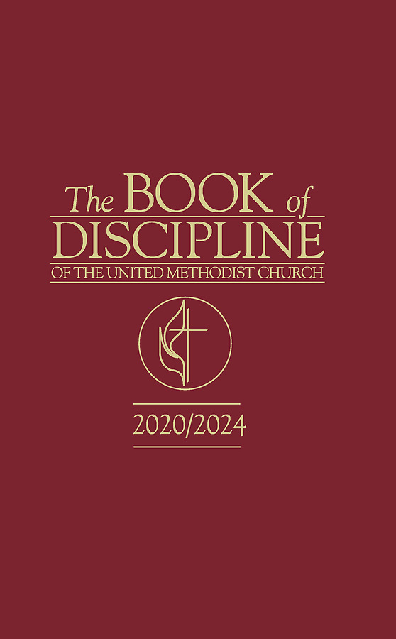
JUDICIAL ADMINISTRATION and
PROCESS in
THE UNITED METHODIST CHURCH
Part 1
Rev. Luan-Vu “Lui” Tran, Ph.D.

Slide 2
Constitutional Structure of the UMC
Our church has three co-equal branches
EPISCOPACY
Council of Bishops
College of Bishops
Resident Bishops
Const. ¶¶ 46-55
JUDICIARY
Judicial Council
Committees on Appeals, Judicial Courts
Const. ¶¶ 56-59
CONFERENCES
General, Jurisdictional, Central, Annual, District, Charge Conference
Const. ¶¶ 9-45
NOTE
UMC polity appears similar but is fundamentally different from U.S. governmt. structure
It is OK to use those labels as long as we know the UM-US differences
EXECUTIVE BRANCH
LEGISLATIVE BRANCH
JUDICIAL BRANCH

Slide 3
Constitutional Principle #1
Separation of Powers
“In The United Methodist Church, no single entity has authority for all ecclesial matters. Each authority center is balanced or constrained by other authorities.” JCD 1312
There are 3 types of Separation of Powers
Structural
Legislative
Procedural

Slide 4
Procedural Separation of Powers
SUPERINTENDING PROCESS
Bishop & Cabinet
JUDICIAL PROCESS
COI, Trial Court, COA, JC
ADMINISTRATIVE PROCESS
BOM, CRC, ARC, AC
“Bishops have no authority to make substantive rulings on judicial or administrative matters that are under the purview of judicial or administrative bodies…” JCD 1092
“The power to make appointments is lodged solely in the office of bishop as stipulated by ¶ 54… of the Constitution. Bishops must consult with district superintendents prior to making and fixing pastoral appointments.” JCD 1307
“The conference relations committee and the conference board of ordained ministry have no disciplinary authority to consider and pass upon a judicial complaint.” JCD 1031
“Questions as to fair process, judicial process, and administrative process must be addressed in the appropriate manner and through the specific bodies set forth in the Discipline.” JCD 1202

Slide 5
Constitutional Principle #2
Fair Process
Procedures established by the Discipline “for the protection of the rights of individuals and for the protection of the Church in administrative [and judicial] hearings.” ¶ 362.2
Procedural rights of persons and of the Church in an administrative or judicial process.
A person’s sense of justice and fairness.
Fair Process
The Judicial Council uses the term in the first two meanings:
“In order to ensure that there shall be due process whenever a member of the ministry or a lay member of the church is accused of violation of any church rule or regulation, the church has adopted procedures to guarantee such due process.” JCD 310

Slide 6

¶ 363.1—Ministerial Review
Ordination and membership in an annual conference in The United Methodist Church is a sacred trust. The qualifications and duties of local pastors, associate members, provisional members, and full members are set forth in [The Discipline], and we believe they flow from the gospel as taught by Jesus the Christ and proclaimed by his apostles. Whenever a person in any of the above categories, including those on leaves of all types, honorable or administrative location, or retirement, is accused of violating this trust, the membership of his or her ministerial office shall be subject to review. The primary purpose of the ministerial review is to resolve any violations of this sacred trust in such a way that God’s work of justice, reconciliation, and healing may be realized.
Clergy Accountability
Judicial Process
Administrative Process

Slide 7





How is the clergy accountability system activated?
under ¶ 363

Slide 8
What is a complaint?
Definition: “A complaint is a written and signed statement claiming misconduct or unsatisfactory performance of ministerial duties.” ¶ 363.2
Elements:
Written
Signed
Statement
Alleging that a clergy person:
  committed one or more chargeable offenses listed in ¶ 2702.1(judicial) and/or
  is ineffective, incompetent, or unable to perform ministerial duties (administrative).

Slide 9
NOTE
Complaint ≠ Grievance
Complaint doesn’t have to be labeled “complaint.”
Complaint must be signed but doesn’t have to be dated to be valid.
Complaint can raise judicial and/or administrative issues.
Terms used in a complaint are indicative but not determinative.
There is no complaint without process.
There is no process without complaint(s).

Slide 10
What happens when a complaint is filed against a clergyperson?
“Upon receiving a written and signed complaint, the Bishop shall, within 90 days, carry out the supervisory response process outlined [in ¶ 363.1(b)-(f)].” ¶ 363.5(a)
Suspension ¶ 363.7
Complaint ¶ 363.2
Supervisory Response ¶ 363.5
Just Resolution Process ¶ 363.6

Slide 11
Supervisory Response Process ¶ 363.5
“The supervisory response of the bishop is pastoral and administrative and shall be directed toward a just resolution among all parties. It is not part of any judicial process. The supervisory response shall be carried out by the bishop or the bishop’s designee in a timely manner, with attention to communication to all parties regarding the complaint and the process. At the determination of the bishop, persons with qualifications and experience in assessment, intervention, or healing may be selected to assist in the supervisory response. The bishop also may consult with the staff/pastor-parish relations committee, the district committee on superintendency for the district superintendents, appropriate personnel committee, or other persons who may be helpful.”

Slide 12
Supervisory Response Process ¶ 363.5
The supervisory response of the bishop shall begin upon receipt of a formal complaint.
The response is pastoral and administrative and shall be directed toward a just resolution among all parties.
It is not part of any judicial process.
The complaint shall be treated as an allegation or allegations during the supervisory process.
At all supervisory meetings no verbatim record shall be made and no legal counsel shall be present.
The person against whom the complaint was made (“Respondent”) may choose another person to accompany him or her with the right to voice.
The person making the complaint (“Complainant”) shall have the right to choose a person to accompany him or her with the right to voice.

Slide 13
Role of Bishop and Cabinet
Receive or initiate complaints about the performance or character of a clergyperson. ¶ 363.4
When a complaint is received, inform in writing the Complainant and Respondent of the process to be followed and of its purpose. ¶ 363.2
Inform those persons in writing when and if the process changes. ¶ 363.2
Notify chairperson of BOM of the complaint, clergyperson, nature of complaint, and, when concluded, its disposition. ¶ 363.5(b)
Conduct the supervisory response within 90 days. ¶ 363.5(a)
Ensure communication to all parties regarding the complaint and the process during supervisory response process. ¶ 363.5
Determine if persons with qualifications and experience in assessment, intervention, or healing should be selected for assistance. ¶ 363.5
Suspend Respondent from ministerial duties for 90 days. ¶ 363.7
Extend suspension for one 30-day period with the consent of Exec. Committee of Board of Ordained Ministry. ¶ 363.7

Slide 14
What are the possible outcomes of the supervisory response?
Bishop or designee conducts supervisory response within 90 days
Dismissing with Cabinet consent ¶ 363.5(f)(1)
Initiating mediated attempt to produce a Just Resolution
¶ 363.5(f)(2)
Referring to Counsel for the Church
¶¶ 363.5(f)(3), 2704.2
Referring to BOM/CRC as administrative matter ¶¶ 355.2(a), 364
The Discipline permits only four different outcomes.

Slide 15
Practical Tips for Handling Complaints
Single-complaint case: determine which allegations are judicial or administrative; use color code (orange for judicial, green for administrative); address each allegation separately; avoid confounding the issues.
Multiple-complaint case: create diagram or chart indicating Who? When? What?; make triage between judicial, administrative, and other types of claims; use color code; merge complaints that are based on same allegations, set of facts and separate those that aren’t.
Make sure that Respondent and Complainant(s) understand which issues are being addressed and stay on topic during meetings/proceedings.
Judicial and administrative complaints can be processed in the same supervisory response if they are discussed separately from each other.
But only judicial complaint(s) can be referred to Counsel for the Church

