Slide 1
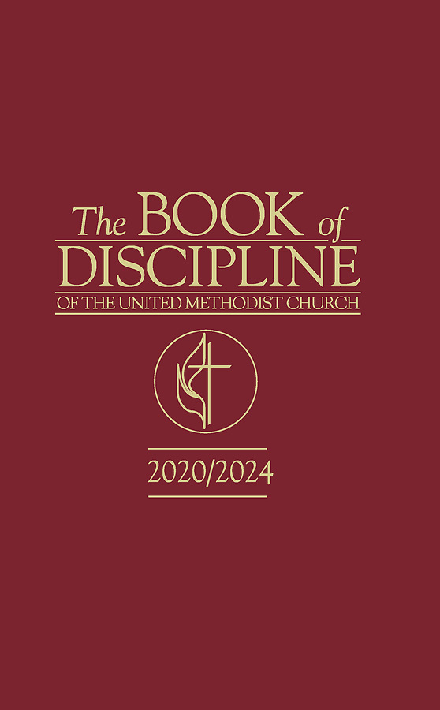
JUDICIAL ADMINISTRATION and PROCESS in THE UNITED METHODIST CHURCH
Part 2
Rev. Luan-Vu “Lui” Tran, Ph.D.

Slide 2
What is a chargeable offense?
The Discipline does not define the term “chargeable offense.”
Unofficial definition: A chargeable offense is a prohibited conduct listed in ¶ 2702.1 that, if committed by a clergyperson, can subject him/her to the complaint process under ¶¶ 363, 2703-2715.
The Discipline does not describe the elements (i.e. legal criteria) of a chargeable offense, except for domestic violence in ¶ 2702.1(l).

Slide 3
What types of chargeable offenses are listed in the Discipline?
Immorality ¶ 2702.1(a)
Crime ¶ 2702.1(b)
Disobedience to the order and discipline of The UMC ¶ 2702.1(c)
Dissemination of doctrines contrary to the established standards of The UMC ¶ 2702.1(d)
Relationships or behavior that undermines the ministry of another pastor ¶ 2702.1(e)
Child abuse ¶ 2702.1(f)
Sexual abuse ¶ 2702.1(g)
Sexual misconduct ¶ 2702.1(h)
Harassment ¶ 2702.1(i)
Racial or gender discrimination ¶ 2702.1(j)
Fiscal malfeasance ¶ 2702.1(k)
Domestic violence ¶ 2702.1(l)

Slide 4
Moratorium on Judicial Proceedigns Concerning Human Sexuality
¶ 2701. 6. In light of the current deep conflict within The United Methodist Church around issues of human sexuality, no judicial proceedings shall be commenced, and all pending judicial proceedings shall be suspended, insofar as such proceedings are based on a complaint, charge, or allegation that the respondent is a “self-avowed practicing homosexual” [...]; that the respondent has conducted, performed, or celebrated a same-gender wedding or other same-gender union; that the respondent has certified, licensed, commissioned, ordained, or consecrated a “self-avowed practicing homosexual”; that the respondent has provided “funds to any gay caucus or group” or used funds “to promote the acceptance of homosexuality”; or that the respondent has otherwise engaged in conduct that the 2016 Book of Discipline of The United Methodist Church stated is “incompatible with Christian teaching.”

Slide 5
Terminology: “Referral”
“Referral” has three meanings in the Discipline:
Referral to Counsel for the Church ¶¶ 363.5(f)(3), 2704.2
Referral to BOM/CRC ¶¶ 355.2(a), 364
Referral to Committee on Investigation ¶¶ 2704.2, 2705
Non-Discovery
Discovery
Supervisory Response
Judicial Process
Administrative Process
Discovery

Slide 6
Referral to Counsel for the Church ¶ 2704.2
If the complaint is not dismissed pursuant to ¶ 363.5(f)(1) and
If the bishop determines that the complaint is based on allegations of one or more offenses listed in ¶ 2702.1…
…the Bishop shall refer the complaint to the counsel for the Church, who shall be appointed by the Bishop.
NOTE
Referral of the complaint to Counsel for the Church is part of the supervisory response, not the judicial process. Respondent and Complainant(s) do not have right of access to records at this stage.
Bishop and Cabinet may not give instructions to or exert improper influence on Counsel of the Church, after a case has been referred.

Slide 7
What happens after a complaint has been referred to Counsel for the Church?
Referral to Counsel for the Church
Counsel for the Church reviews complaint and
submits Judicial Complaint to COI within 180 days
or refers case back to Bishop
NOTE
Communication between CC and COI is subject to discovery and must be shared with Respondent.
NOTE
Communication between Bishop, Cabinet and CC is not subject to discovery at this stage.
NOTE
CC may not refer a complaint directly to BOM, even if he/she determines that it is an administrative matter.

Slide 8
Role of Counsel for the Church ¶ 2704.2
Must be clergyperson in full connection (if Respondent is a clergy member). ¶ 2704.2(a)
Must not be a member of the Cabinet, BOM, or COI who has earlier considered the case. ¶ 2708.7
Appointed by the bishop. ¶ 2704.2(a)
Represents the interests of the Church in pressing the claims of the Complainant(s).
Must be willing to uphold Church law and Discipline, by agreeing to serve. ¶ 2704.2(a)
Is not bound by Cabinet’s findings (separation of powers).
May have Assistant Counsel, who may be an attorney but without voice. ¶ 2706.1(a)
Makes independent determination as to whether evidence of the case supports charges.
If YES: drafts and submits Judicial Complaint to Committee on Investigation within 180 days. ¶ 2704.2(b).
If NO: refers case back to Bishop and Cabinet with explanation.

Slide 9
Role of Counsel for Respondent ¶ 363.5(d), ¶ 2706.2(c)
Selected by the Respondent.
Must be clergyperson in full connection (if Respondent is a clergy member).
Must not be a member of the Cabinet, BOM, or COI who has earlier considered the case. ¶ 2708.7
Represents and defends the interests of the Respondent in supervisory response process (¶ 363.5), judicial proceedings (¶¶ 2703-2714), and appeal (¶¶ 2715-2719).
Is bound by instructions and serves at the pleasure of Respondent.

Slide 10
Role of Counsel for Complainant ¶¶ 363.5(d), 2701.1(c)
Can be lay or clergy but without voice in supervisory response.
Can be an attorney but without voice in judicial proceedings.
Must not be a member of the Cabinet, BOM, or COI who has earlier considered the case. ¶ 2708.7
Selected by the Complainant.
Represents and defends the interests of the Complainant in supervisory response process (¶ 363.5), judicial proceedings (¶¶ 2703-2714), and appeal (¶¶ 2715-2719).
Is bound by instructions and serves at the pleasure of Complainant.

Slide 11

When does a complaint become a judicial complaint?
Supervisory Response ¶ 363.5
Just Resolution ¶ 363.6
Dismissal with consent of Cabinet ¶ 363.5(f)(1)
Referral to Counsel for the Church ¶ 363.5(f)(3), 2704.2
Referral to BOM ¶¶ 355.2(a), 364
Suspension ¶ 363.7
Committee on Investigation
Counsel for the Church submits judicial complaint ¶ 2704

Slide 12
Main differences between administrative and judicial process
 | ADMINISTRATIVE PROCESS | JUDICIAL PROCESS
Initiator/Complainant | Often but not always Bishop/Cabinet | Often but not always individual (victim)
Complaint | Allegations of incompetence, ineffectiveness, or inability to perform ministerial duties. ¶ 355.2(b) | Allegations of “misconduct as defined in ¶ 2702.1” (i.e. chargeable offenses) ¶ 363.2
Process | Administrative Fair Process ¶¶ 362-364 | Fair Process in Judicial Proceedings ¶¶ 2701-2719
Parties/Bodies | Clergy person and counsel Cabinet rep. Board of Ordained Ministry Conference Relations Committee | Clergy person and counsel Counsel for the Church, assistant counsel Complainant and counsel Committee on Investigation
Final decision | Clergy Session | Trial Court
Review/Appellate Bodies | ARC – mandatory review ¶ 635 ARC – appellate review ¶ 2719.3-4 Jurisdictional Committee on Appeals Judicial Council | Jurisdictional Committee on Appeals Judicial Council

Slide 13
Complaint filed against clergy person alleging “sexual harassment”
¶ 2702.1(i)
Supervisory Response
¶ 363.5
Just Resolution not achieved within 90 days
Cabinet requests Involuntary Leave of Absence under ¶ 355
CRC conducts hearing to determine if clergy person should be placed on ILOA under ¶ 362.2
ARC conducts mandatory or appellate review
NOTE
A judicial complaint cannot be prosecuted through administrative procedures. Nor can an administrative complaint be resolved through judicial process

