Slide 1
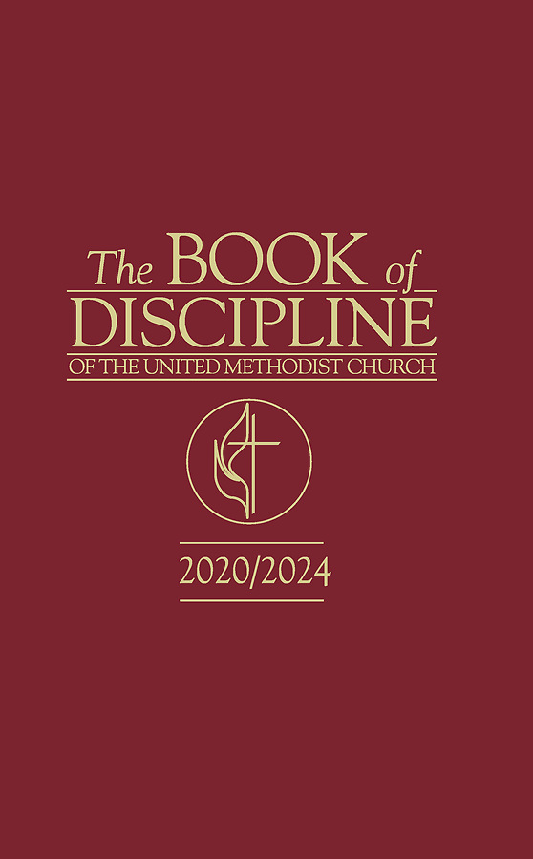
JUDICIAL ADMINISTRATION and
PROCESS in
THE UNITED METHODIST CHURCH
Part 3
Rev. Luan-Vu “Lui” Tran, Ph.D.

Slide 2
Constitutional Principle #2
Fair Process
Procedures established by the Discipline “for the protection of the rights of individuals and for the protection of the Church in administrative [and judicial] hearings.” ¶ 362.2
Procedural rights of persons and of the Church who are involved in an administrative or judicial process.
A person’s sense of justice and fairness.
Fair Process
NOTE
Fair process rights listed in ¶ 2701 apply only upon referral of a judicial complaint to the Committee on Investigation.

Slide 3
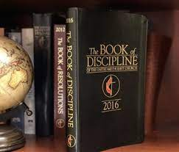
Fair Process Rights of the Complainant ¶ 2701.1
Complainant has:
  Right to be heard
  Right to notice of hearings
  Right to counsel
  Right to be informed of resolution

Slide 4

Fair Process Rights of the Respondent ¶ 2701.2
  Respondent has:
    Right to be heard
    Right to notice of hearings
    Right to counsel
    Right against double jeopardy
    Right of access to records
    Right to be presumed innocent
Possible: Right to racially diverse and gender-inclusive Trial Court? ¶¶ 2709.2, 2713.3(a)

Slide 5
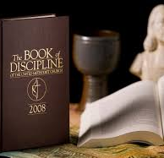
Fair Process Rights of the Church ¶ 2701.3
    The Church has:
      Right to be heard
      Right of access to records
Possible: Right to racially diverse and gender-inclusive Trial Court? ¶¶ 2709.2, 2713.3(a)

Slide 6
The Five Phases of the Judicial Process
5
Referral to COI
¶¶ 2704-2705
Investigation
¶¶2703, 2706
Pre-Trial
¶ 2708.3
Trial
¶¶ 2707-2714
Appeal
¶¶ 2715-2718
4
3
2
1

Slide 7
Phase 1: Referral to COI
Referral to COI
¶¶ 2704-2705
Investigation
¶¶2703, 2706
Pre-Trial
¶ 2708.3
Trial
¶¶ 2707-2714
Appeal
¶¶ 2715-2718

Slide 8
The Work of Counsel for the Church
When reviewing the complaint(s), the Counsel for the Church:
  has to make sure that the case file is complete—including documents from supervisory response and other relevant materials.
  needs to separate judicial from administrative matters and focus only on the judicial.
  must notify Bishop if he/she determines that the case contains administrative issues and, if warranted, refer them back to the Bishop/Cabinet. In complex multi-complaint cases, CC should seek authorization to prosecute remaining judicial matters.
  may conduct further investigation to collect evidence: interviewing witnesses, requesting documents from law enforcement authorities, accessing open-source materials.
  makes independent determination as to whether the evidence supports the allegations.
  must consider the statute of limitations prior to submitting the judicial complaint. ¶ 2704.2(a)
  may request that reasonable expenses (e.g. Assistant Counsel, office supplies) be paid by the annual conference.

Slide 9
Preparing the Judicial Complaint ¶ 2704.2
If Counsel for the Church determines that there is sufficient evidence, he/she shall:
  draft and sign a judicial complaint
  attach as exhibits all relevant written materials, including but not limited to information from the supervisory process and a suggested list of witnesses as deemed appropriate
  forward the judicial complaint to the chairperson of the Conference Committee on Investigation
  send copy of the complaint and documentary evidence to the Respondent, Complainant, and Bishop (“discovery”).

Slide 10
Form of the Judicial Complaint ¶ 2705
The Judicial Complaint shall:
  explain to the COI the alleged events sourrounding and relating to one or more chargeable offenses listed in ¶ 2702
  include the appropriate chargeable offenses and proposed specifications
  have as attachments all relevant documents and other exhibits supporting the complaint.
All relevant documents and other exhibits supporting the judicial complaint may be attached.
  A true copy of the complaint and reproducible documents and exhibits shall be sent by Counsel for the Church to the Respondent, his/her Counsel and the Bishop at the same time as they are sent to the COI.

Slide 11
Phase 2: Investigation
Referral to COI
¶¶ 2704-2705
Investigation
¶¶2703, 2706
Pre-Trial
¶ 2708.3
Trial
¶¶ 2707-2714
Appeal
¶¶ 2715-2718

Slide 12
Composition of the Committee on Investigation ¶ 2703.2
4 clergy members in full connection, 3 lay members, 3 alternate clergy members in full connection, and 6 alternate lay members.
Nominated by Bishop in consultation with BOM and Board of Laity.
Elected quadrennially by the Annual Conference.
Members must be in good standing and be deemed of good character.
COI should reflect racial, ethnic and gender diversity.
COI members and alternates must not be members of BOM, Cabinet, or immediate family members of the above.
Member who has been a party to any of the prior proceedings in the case coming before the COI is disqualified from sitting on the COI in that case.
Quorum is 7 members or alternates seated.

Slide 13
Role of Committee on Investigation
¶ 2706
conducts an investigation into the allegations made in the judicial complaint and determines if reasonable grounds exist to bring a bill of charges and specifications to trial.
may request the Bishop to suspend the Respondent from all clergy responsibilities. ¶ 363.7
prepares, signs, and certifies a bill of charges and specifications, if reasonable grounds exist.
determines whether reasonable grounds exist to support the charges, not guilt or innocence.
NOTE
Standard of review is reasonable grounds. COI is not bound by the evidentiary findings of Counsel for the Church.

Slide 14
Overview of COI Procedures
Basic procedural decisions on: motion to dismiss charges, motions to introduce evidence, motions in limine, hearing schedule, venue, and security
NOTE
COI determines independently what evidence should be included or excluded.
Counsel for the Church may propose but does not control introduction of evidence.
Preliminary Meeting
Hearing
Deliberations
Certification of Bill of Charges
COI examines witnesses and other evidence. Witnesses can be deposed outside of hearing. Parties have no right to cross-examination.
COI deliberates and votes on each charge and specification. Five votes are required to adopt each one.
If there are sufficient votes, COI certifies and refers the Bill of Charges to the parties, Secretary of Annual Conference, and resident Bishop.
Pre-Trial/Trial

Slide 15
What happens if COI decides not to certify Bill of Charges?
COI certifies
NO bill of charges
Counsel for the Church refers case back to Bishop with recommendation to:
Dismiss case with consent of Cabinet under ¶ 363.5(f)(1)
Refer case to BOM as administrative matter under ¶¶ 355, 364
Counsel for the Church files interlocutory appeal under ¶ 2716.10
Committee on Appeals
Judicial Council
Initiate mediated attempt to produce just resolution under ¶ 363.5(f)(2)

Slide 16
What is an “interlocutory appeal” and where is it enacted in the Discipline?
“Interlocutory” means provisional, interim, temporary, or not final. Thus, “interlocutory appeal” refers to an appeal of a matter, which does not determine the disposition of a case, but which is necessary for a suitable adjudication of the merits.
JCD 1361, p. 3, n. 1

Slide 17
¶ 2716.10
The Church shall have no right of appeal from findings of the trial court. In regard to cases where there is an investigation under ¶ 2702, but no trial is held, egregious errors of Church law or administration may be appealed to the jurisdictional or central conference committee on appeals and then to the Judicial Council by counsel for the Church. The committee on investigation’s decision not to certify a bill of charges does not alone constitute an egregious error of Church law or administration. When the committee on appeals shall find egregious errors of Church law or administration under this part, it may remand the case for a new hearing, in which event it shall return to the chair of the committee on investigation a statement of the grounds of its action. This is not to be double jeopardy.

Slide 18
Phase 3: Pre-Trial
Referral to COI
¶¶ 2704-2705
Investigation
¶¶2703, 2706
Pre-Trial
¶ 2708.3
Trial
¶¶ 2707-2714
Appeal
¶¶ 2715-2718

Slide 19
Overview of Pre-Trial
Presiding Officer
(Judge)
Counsel for the Church
Counsel for Respondent
Objections: lack of jurisdiction, statute of limitations expired, double jeopardy, lack of notice
Motions: for dismissal, amending Bill of Charges, change of venue, continuance, in limine
Parties may raise procedural objections and file motions in pre-trial proceedings. ¶ 2708.3
rules on all objections and motions, grants continuances
Pre-trial proceedings are done mostly by phone and email and involve only presiding officer and counsels for both parties.

Slide 20
Phase 4: Trial
Referral to COI
¶¶ 2704-2705
Investigation
¶¶2703, 2706
Pre-Trial
¶ 2708.3
Trial
¶¶ 2707-2714
Appeal
¶¶ 2715-2718

Slide 21
Organization & Composition of Trial Court
Secretary
Presiding Officer
Legal Counsel
NOTE
Trial Court determines questions of fact and law
Trial Court
13 members and
2 alternates selected from a pool of 35 clergy in full connection

Slide 22
Overview of Trial
Convening of Trial
Resident Bishop sets the date and place and convenes the trial.
Selection of Trial Court
Voir Dire: Counsels examine, select, reject members from the Trial Court (Jury) Pool.
Each party has up to 4 peremptory challenges and unlimited challenges for cause.
Presentation o f Evidence
Each counsel may make opening statement.
Deliberation and Verdict
Penalty Phase
Evidence presented by questioning of witnesses and documents shown to be reliable.
Respondent enters plea of “guilty” or “not guilty.”
After closing arguments by counsels, Presiding Officer gives instructions.
Trial Court deliberates and votes on each charge/specification. 9 votes necessary.
Counsels present further evidence and oral arguments regarding the penalty.
Trial Court deliberates and votes on the penalty. 7 votes necessary.

Slide 23
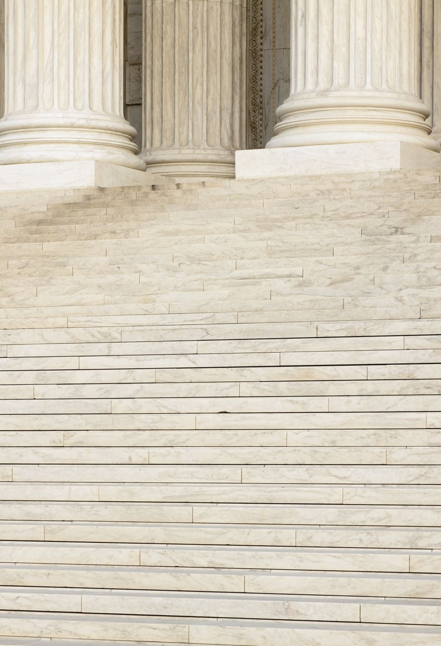
Rules of Evidence
The Discipline has only three rules of evidence:
  Only relevant and reliable evidence is admissible. ¶¶ 2706.4(d), 2710.9
  Only evidence within the six-year statute of limitation is admissible. ¶ 2710.9
  Burden of proof is clear and convincing. ¶ 2711.2
  Presiding Officer rules on whether evidence is relevant and reliable.
  What constitutes “relevant and reliable”?
    Probative vs. Prejudicial
    Direct Testimony vs. Hearsay
    Factual vs. Speculative

Slide 24
Phase 5: Appeal
Referral to COI
¶¶ 2704-2705
Investigation
¶¶2703, 2706
Pre-Trial
¶ 2708.3
Trial
¶¶ 2707-2714
Appeal
¶¶ 2715-2718

Slide 25
Overview of Appeals Process
Trier of Fact
Court of Original Jurisdiction
Appellate Court of 1st Instance
Appellate Court of 2nd Instance
Trial Court
Respondent and the Church can appeal within 30 days of the decision.
Committee on Appeals
Respondent and the Church can appeal within 30 days of the decision.
Judicial Council
Decision of the Judicial Council is final and ends the appeals process.

Slide 26
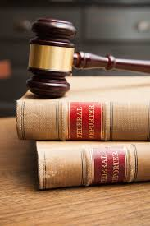
Standard of Appellate Review ¶ 2716.7
The appellate body shall determine two questions only: (a) Does the weight of the evidence sustain the charge or charges? (b) Were there such errors of Church law as to vitiate the verdict and/or the penalty?
These questions shall be determined by the records of the trial and the argument of counsel for the Church and for the respondent.
The appellate body shall in no case hear witnesses.

